Slide 1


Teaching HPC with a small Raspberry Pi Cluster
Colin Sauze <cos@aber.ac.uk>
Research Software Engineer
Super Computing Wales Project
Aberystwyth University

Slide 2
Overview
Inspirations
Why teach HPC with Raspberry Pi?
My Raspberry Pi cluster
Experiences from teaching
Future Work

Slide 3
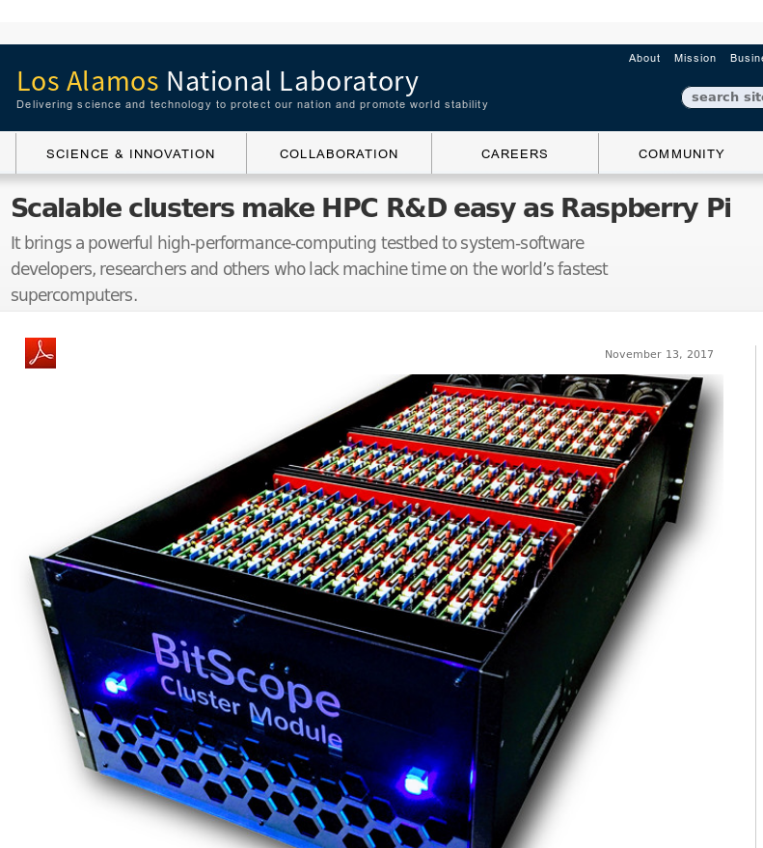
Inspiration #1: Los Alamos National Laboratory
750 node cluster
Test system for software development
Avoid tying up the real cluster

Slide 4
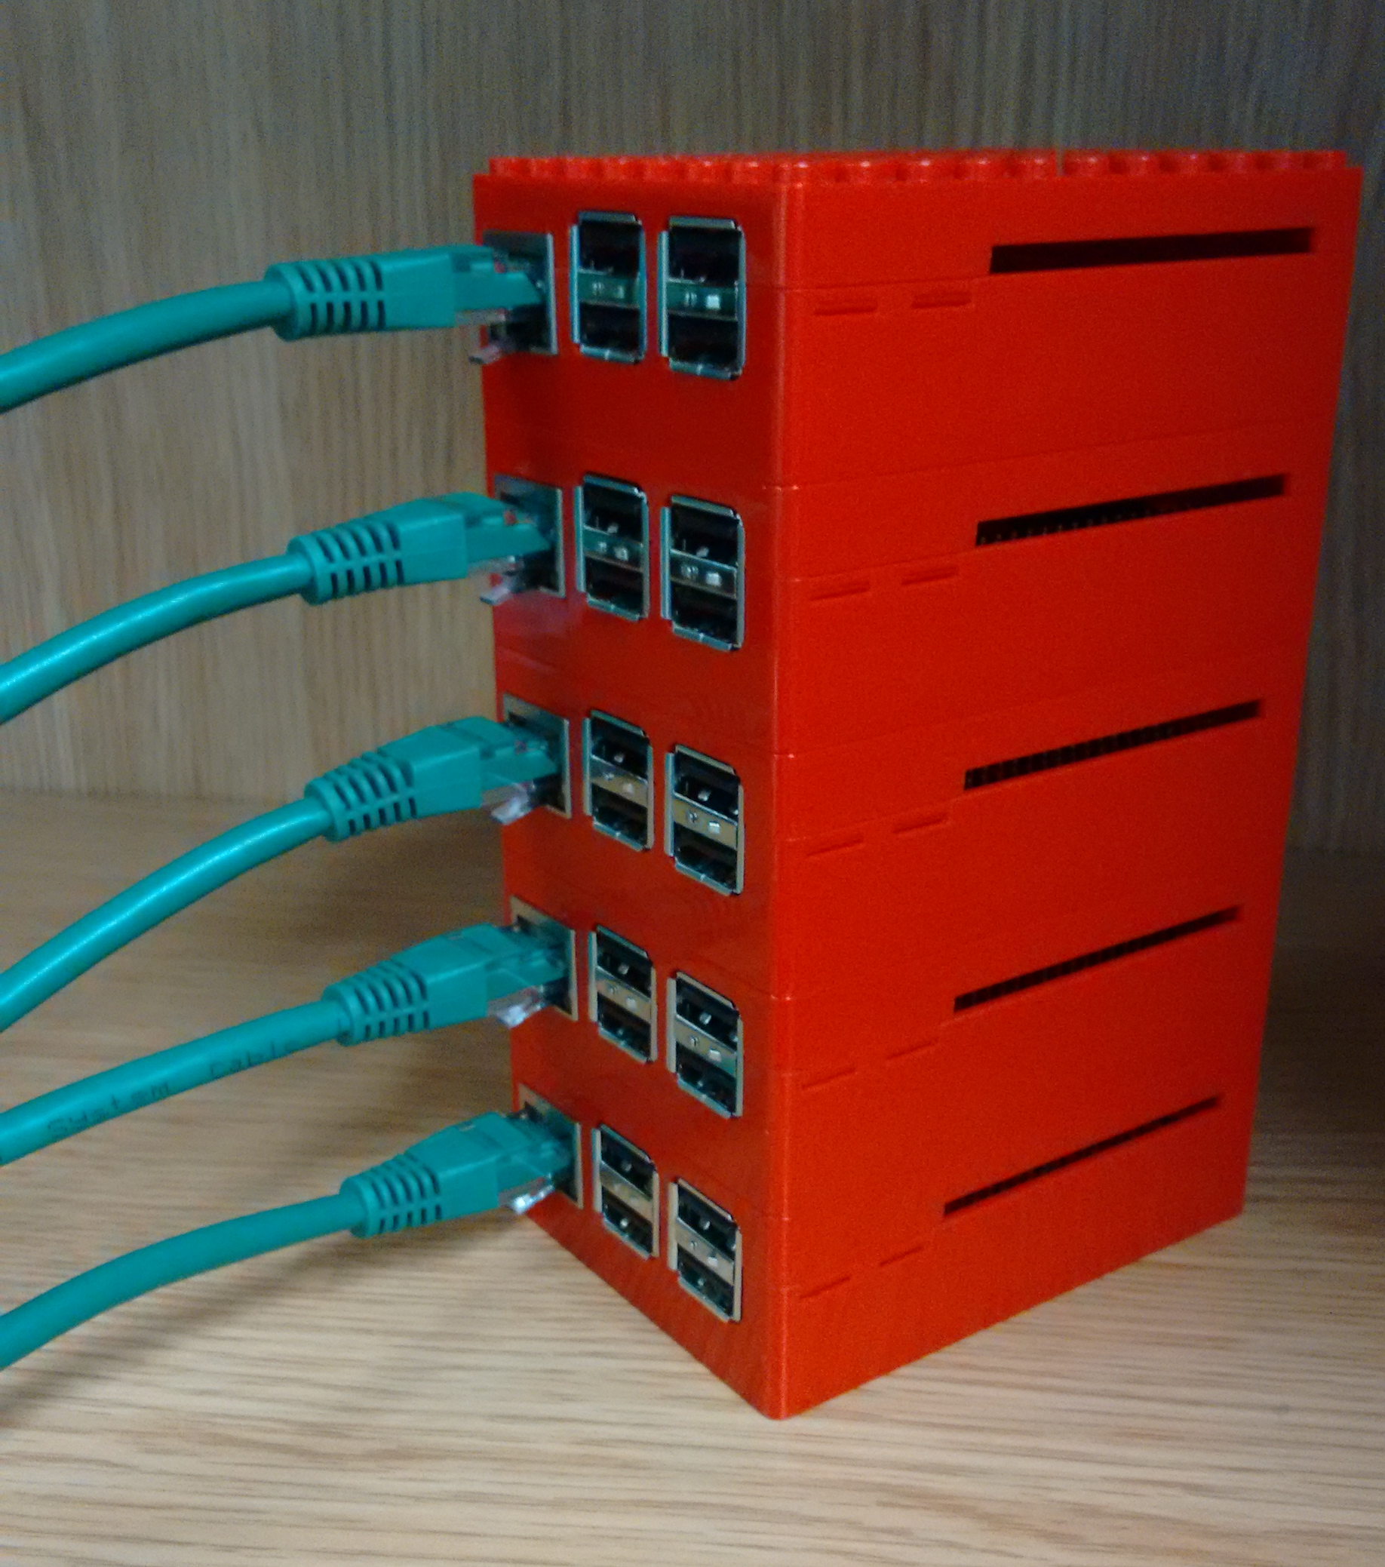
Inspiration #2: Wee Archie/Archlet
EPCC’s Raspberry Pi Cluster
Archie: 18x Raspberry Pi 2’s (4 cores each)
Archlet: smaller 4 or 5 node clusters.
Used for outreach demos.
Setup instructions: https://github.com/EPCCed/wee_archlet
Image from https://raw.githubusercontent.com/EPCCed/wee_archlet/master/images/IMG_20170210_132818620.jpg

Slide 5
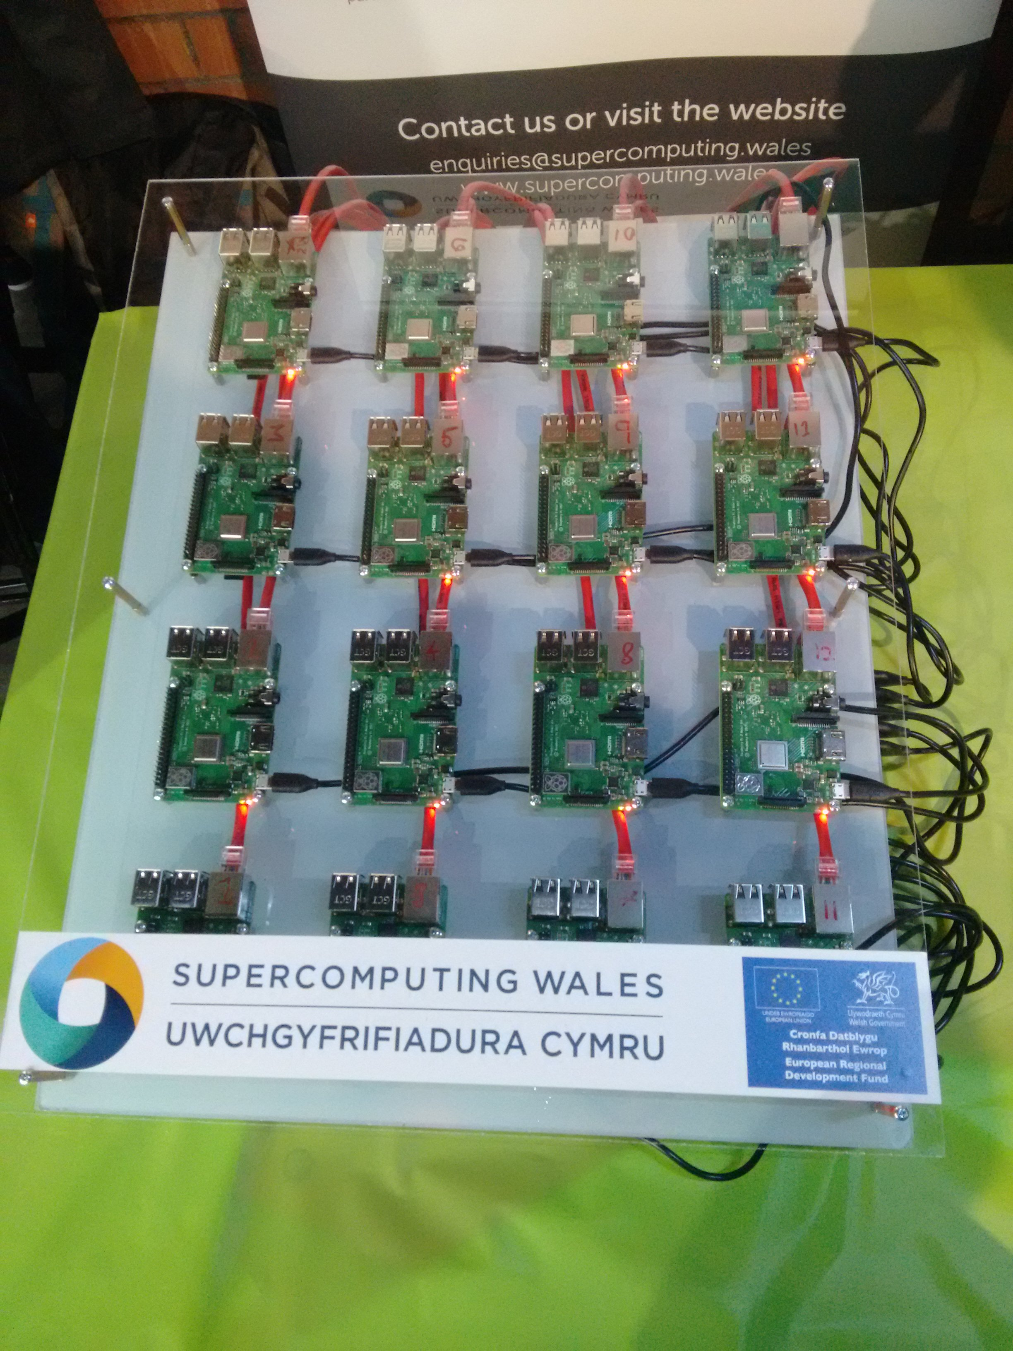
Inspiration #3: Swansea’s Raspberry Pi Cluster
16x Raspberry Pi 3s
CFD demo using a Kinect sensor
Demoed at the Swansea Festival of Science last year
More about this in Ed Bennett’s talk on 12pm tomorrow

Slide 6
Why Teach with a Raspberry Pi cluster?
Avoid loading real clusters doing actual research
  Less fear from learners that they might break something
Resource limits more apparent
More control over the environment
Hardware less abstract
No need to have accounts on a real HPC

Slide 7
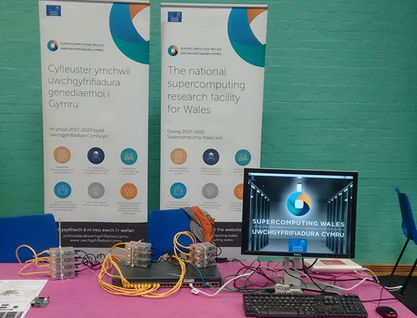
My Cluster
“Tweety Pi”
  10x Raspberry Pi model B version 1s
  1x Raspberry Pi 3 as head/login node
  Raspbian Stretch
  Slurm job manager
Head node acts as WiFi access point
  Internet via phone or laptop
Used a British Science Week 2019
  Simple Pi with Monte Carlo methods demo

Slide 8
Teaching Materials
Based on Introduction to HPC with Super Computing Wales carpentry style lesson:
  What is an HPC?
  Logging in
  Filesystems and transferring data
  Submitting/monitoring jobs with Slurm
  Profiling
  Parallelising code, Amdahl’s law
  MPI
  HPC Best Practice

Slide 9
Experiences from Teaching
Ran two courses, part of STFC summer school
15 people each time
  1st time using HPC for many
  Most had some Unix experience
Subset of Super Computing Wales introduction to HPC carpentry lesson
Slurm issues during first workshop
Worries about WiFi

Slide 10
Technical Problems
Compute nodes run root filesystem over NFS from the head node
Created accounts on the head node
Copied /etc/passwd to the NFS share
Original files were different, extra Slurm related system user on the nodes
Broke Slurm :(
Fixed for second group

Slide 11
Feedback
Very Positive
A lot seemed to enjoy playing around with SSH/SCP
  First time using a remote shell for some
  Others more adventurous than they might have been on a real HPC
Main complaint was lack of time (only 1.5 hours)
  Only got as far as covering basic job submission
  Quick theoretical run through of MPI and Amdahl’s law
  Probably have 3-4 hours of material
Queuing became very apparent
  10 nodes, 15 users
  “watch squeue” running on screen during practical parts

Slide 12
Future Work
More complete setup instructions (link on next slide)
Script based install
CentOS/Open HPC stack instead of Raspbian
Use for full intro to SCW course
  Hybrid of Raspberry Pi and real cluster
Public engagement demo which focuses on our research
  Analysing satellite imagery
  Simulate the monsters from MonsterLab (https://monster-lab.org/)

Slide 13
More Information
My setup instructions - https://github.com/colinsauze/pi_cluster
Teaching material - https://github.com/SCW-Aberystwyth/Introduction-to-HPC-with-RaspberryPi
Email me: cos@aber.ac.uk

